Slide 1
ArCLab computer clusters
https://clusterportal.feit.uts.edu.au/pages/home

Slide 2
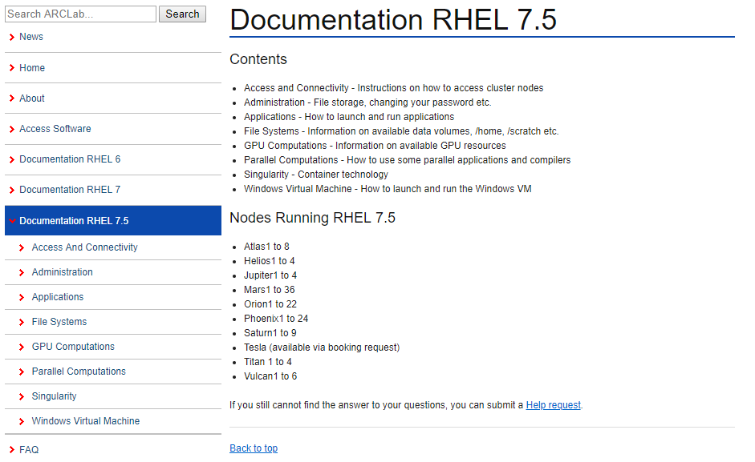
https://clusterportal.feit.uts.edu.au/pages/documentation_rhel75

Slide 3
